Slide 1
AUD401
Dynamic Audio for Digital Media
Lecture 2 ~ Pure Data / Sampling
Dr Christos Michalakos
c.michalakos@abertay.ac.uk

Slide 2
Today
Digital Audio
Pd Tour
Tutorial

Slide 3
Acoustic to Digital

Slide 4
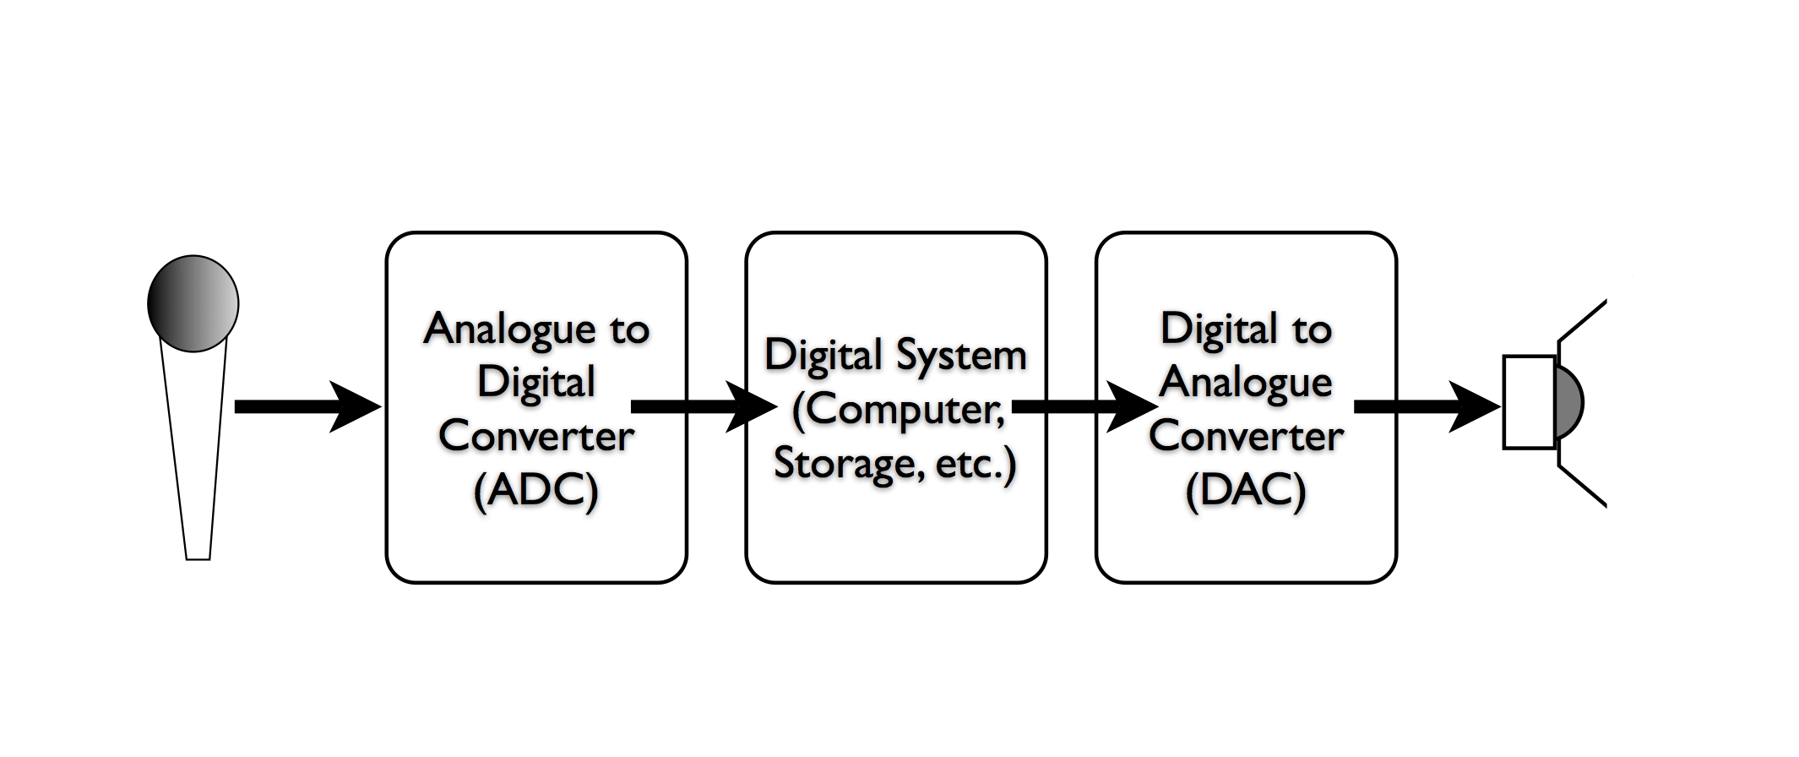
Sampling

Slide 5
Sampling Rate

Slide 6
Bit Depth

Slide 7
Metroid - 8bits- NES
2 = 256 possible amplitude
Metroid II - 4bits - Gameboy
2 = 16 possible amplitude positions
Super Metroid - 16bits - SNES
2 = 65,536 possible amplitude positions
8
4
16

Slide 8
Clipping

Slide 9
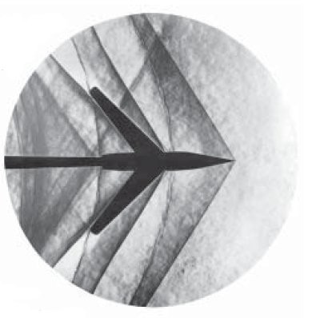

Slide 10
Back to Pd…

Slide 11
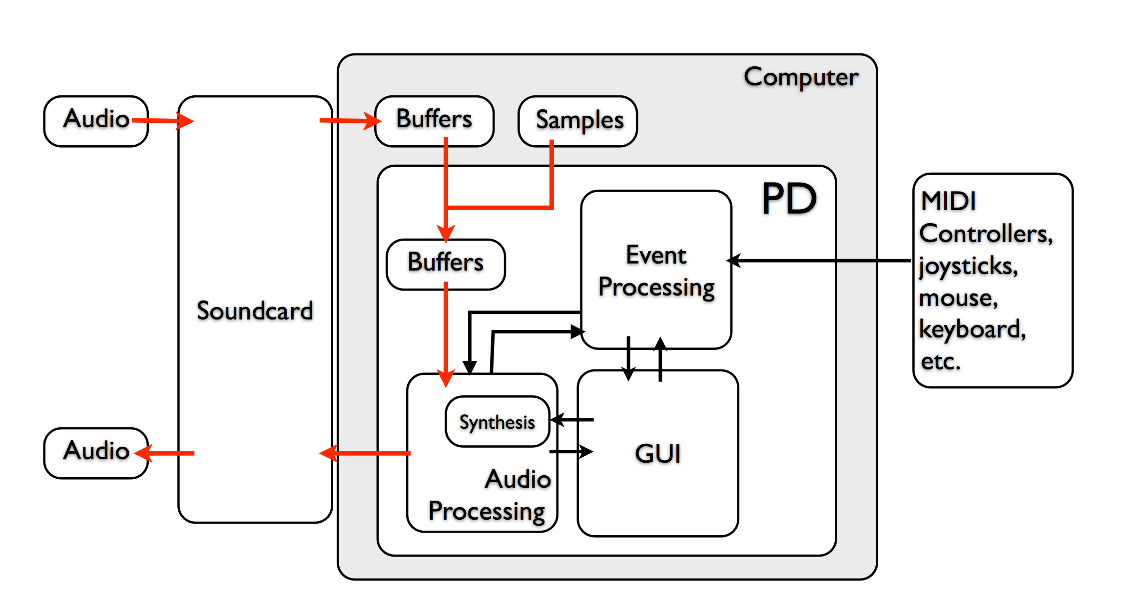
Architecture

Slide 12
Tutorial

Slide 13
Pure Data = Objects + Data

Slide 14
Pd Operation Modes
Edit Mode
Run Mode
Switch between them by
Command+E (Mac) or Control+E (Win)

Slide 15
Pd Control VS Audio Rate
Audio Rate Objects with tilde (osc~, phasor~ etc)
Thick dark patch cords
Dark inlets Audio turns ON (Cmd /) and OFF(Cmd .)
Control Rate
All the rest

Slide 16
So, what Pd objects are there?
http://en.flossmanuals.net/pure-data/ch072_introduction/

Slide 17
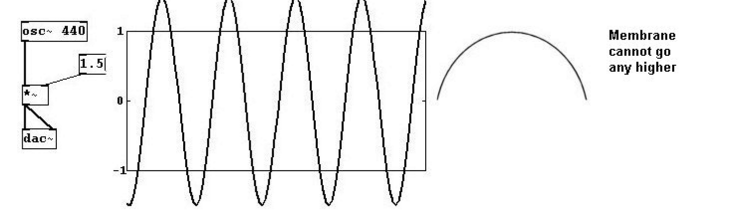
Limits
Amplitude: 0 to 1
Signal Values: -1 to 1

